Slide 1

SIGN LANGUAGE TO TEXT AND SPEECH CONVERSION
DEPARTMENT OF COMPUTER SCIENCE AND ENGINEERING
Batch - 02
Under the Esteemed Guidance of
Mr . K. NagaRaju , M .Tech, (Ph.D.)
Associate Professor
Final Review
Y. DURGA NAVEEN - 20T91A05A2
GIET ENGINEERING COLLEGE
Accredited by NAAC, Affiliated to JNTUK, Kakinada, Chaitanya Knowledge City, Velugubanda, Rajamahendravaram 533 296,Andhra Pradesh, India.
2023-2024

Slide 2

CONTENTS
ABSTRACT
INTRODUCTION
MOTIVATION
EXISTING SYSTEM WITH LIMITATIONS
PROPOSED SYSTEM WITH ADVANTAGES
REQUIREMENTS OF SOFTWARE AND HARDWARE
MODULES
UML DIAGRAMS
SCREENSHOTS
CONCLUSION
REFERENCE

Slide 3
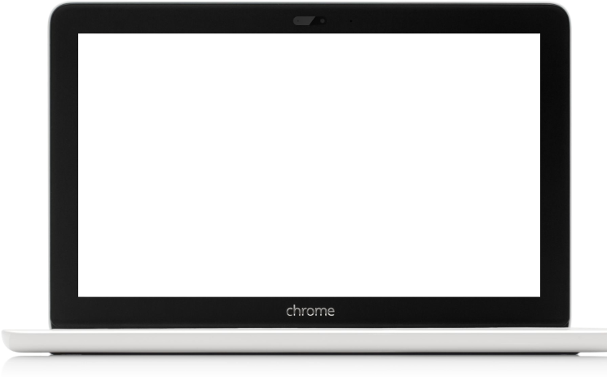
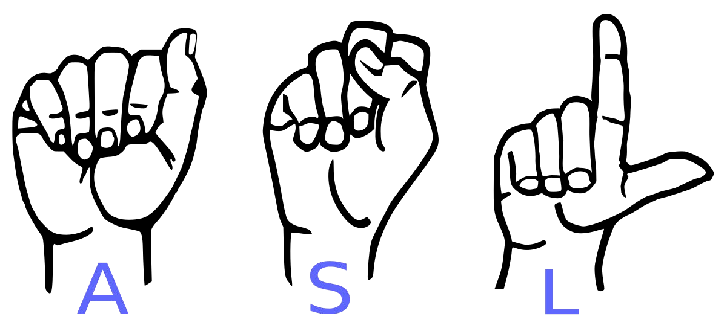
SIGN LANGUAGE TO TEXT AND SPEECH CONVERSION
USING MACHINE LEARNING AND CONVOLUTIONAL NEURAL NETWORK

Slide 4

Sign language is one of the oldest and most natural form of language for communication, but since most people do not know sign language and interpreters are very difficult to come by, we have come up with a real time method using neural networks for fingerspelling based American sign language. In our method, the hand is first passed through a filter and after the filter is applied the hand is passed through a classifier which predicts the class of the hand gestures. Sign language consists of gestures and expressions used mainly by the hearing-impaired to talk. Our project aims to create a computer application and train a model which when shown a real time video of hand gestures of American Sign Language shows the output for that particular sign in text format on the screen.
ABSTRACT

Slide 5
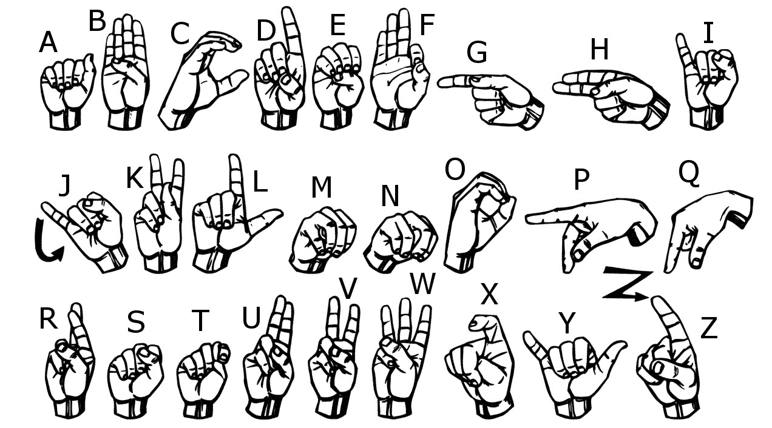
INTRODUCTION
American sign language is a predominant sign language Since​ the only disability Deaf & Dumb people have is communication related and they cannot use spoken languages hence the only way for them to communicate is through sign language. Communication is the process of exchange of thoughts and messages in various ways such as speech, signals, behaviour and visuals. Deaf and Dumb(D&M) people make use of their hands to express different gestures to express their ideas with other people. Gestures are the nonverbally exchanged messages and these gestures are understood with vision. This nonverbal communication of deaf and dumb people is called sign language.
In our project we basically focus on producing a model which can recognize Fingerspelling based hand gestures in order to form a complete word by combining each gesture.

Slide 6
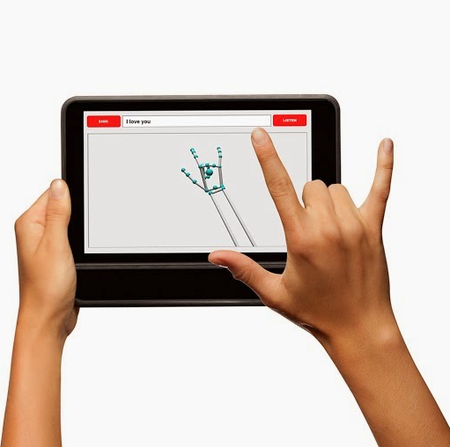
MOTIVATION
For interaction between normal people and Deaf & Dumb people a language barrier is created as sign language structure which is different from normal text. So they depend on vision based communication for interaction. If there is a common interface that converts the sign language to text the gestures can be easily understood by the other people. So research has been made for a vision based interface system where Deaf & Dumb people can enjoy communication without really knowing each other's language. The aim is to develop a user friendly human computer interfaces (HCI) where the computer understands the human sign language.

Slide 7
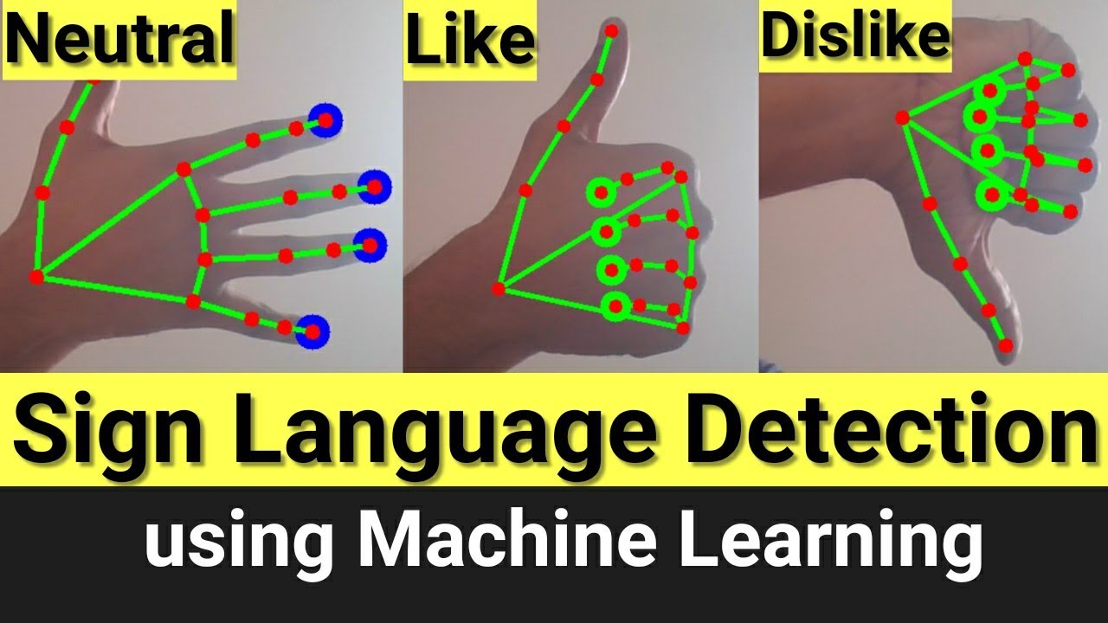
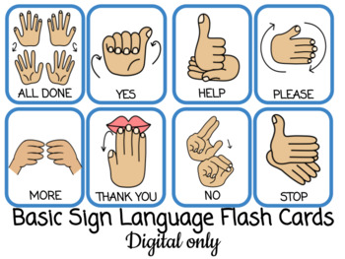
EXISTING SYSTEM WITH LIMITATIONS
EXISTING SYSTEM
An existing system for sign language to text conversion is a system that uses computer vision and natural language processing techniques to translate sign language gestures into text. Existing system are struggle with complex signs, variations in signing styles, and real-time processing requirements. The existing system have been able to recognize gestures with high latency as it uses only image processing. Accuracy remains a challenge, especially in complex sentences with rapid signing and background noise.

Slide 8
LIMITATIONS
The model works well only in good lighting conditions.
Plain background is needed for the model to detect with accuracy.
High cost and complexity.

Slide 9
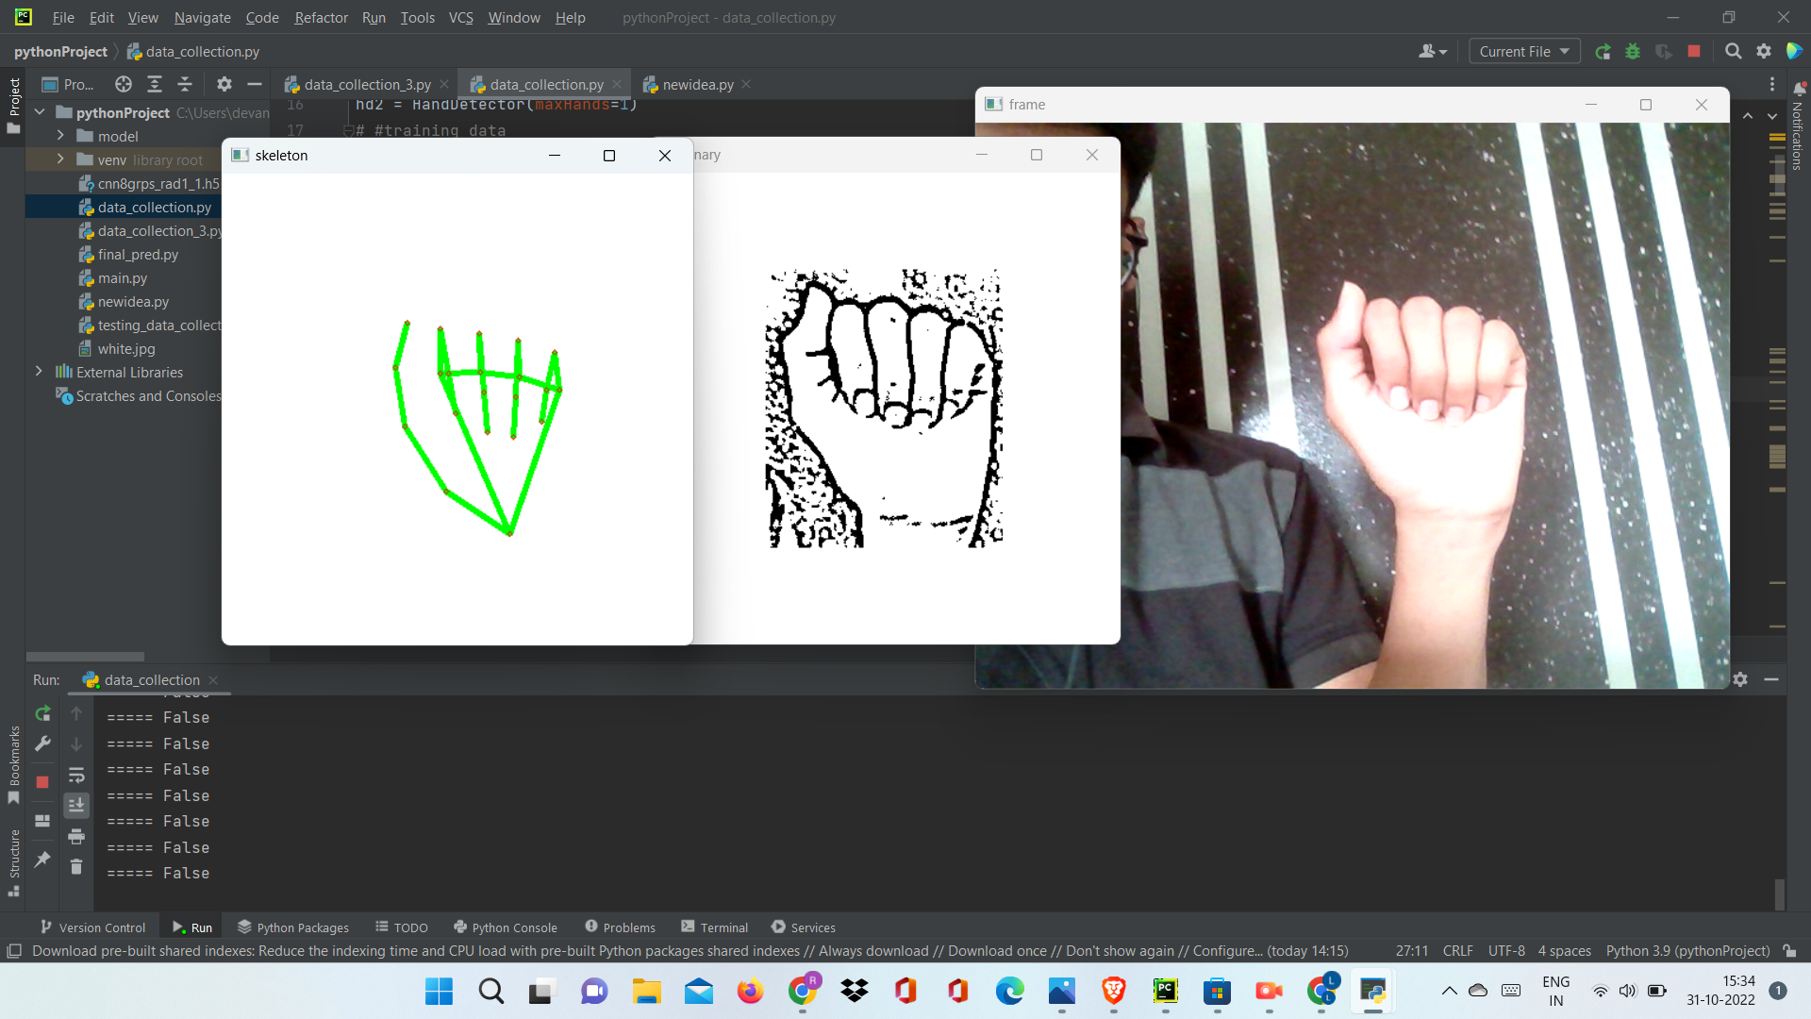
PROPOSED SYSTEM WITH ADVANTAGES
PROPOSED SYSTEM
Our proposed system is sign language to text and speech conversion using Convolutional Neural Networks which recognizes various hand gestures by capturing video and converting it into frames. Then the hand pixels are segmented and the image it obtained sent for comparison to the trained model. Thus our system is more robust in getting exact text labels of letters. The purpose of the system is to improve the existing system in terms of response time and accuracy with the use of efficient algorithms, high quality data sets and better sensors.

Slide 10

ADVANTAGES
Accuracy
Social Inclusion
Communication Bridge
Accessibility
Enhanced Independence
Educational support
Legal Compliance

Slide 11
REQUIREMENTS OF SOFTWARE AND HARDWARE
Software
Hardware
Operating System : Windows 10/11
Programming Language: Python 3.9
IDE: Visual Studio Code
Libraries: Tensorflow, OpenCV, Numpy, Keras, Mediapipe, pyttsx3, Tkinter, PIL
System : Dual Core
Hard Disk : 250GB
RAM : 8Gb
Webcam

Slide 12
MODULES
1. Dataset Creation
2. Data Preprocessing
3. Model Training
4. Gesture Recognition
5. Text Generation and Text-to-Speech Translation
SYSTEM
1 Dataset Creation:
Collect a dataset containing images or videos of sign language gestures.
Annotate the dataset with corresponding text labels (e.g., words or phrases) for each gesture.
2 Data Preprocessing:
Resize and reshape the images or videos to a consistent format.
Split the dataset into training and testing subsets.
3 Model Training:
Choose an appropriate machine learning model (e.g., Convolutional Neural Networks).
Train the model using the pre-processed dataset to recognize sign language gestures.

Slide 13
4 Gesture Recognition:
The system processes the captured gestures using the trained model.
The model predicts the corresponding text labels for each gesture.
5 Text Generation and Text-to-Speech Translation:
Convert the predicted text labels into complete sentences or phrases.
Utilization of pyttsx3 library for text-to-speech conversion
USER
User Interaction:
Develop an interface (e.g., a mobile app or web application) for users to interact with the system.
Users can capture sign language gestures using a camera or webcam.
Real-Time Communication:
Users can express themselves using sign language, and the system translates it into text.
Overall, the user’s role involves contributing to dataset creation, interacting with the system, and benefiting from improved communication facilitated by sign language to text conversion.

Slide 14
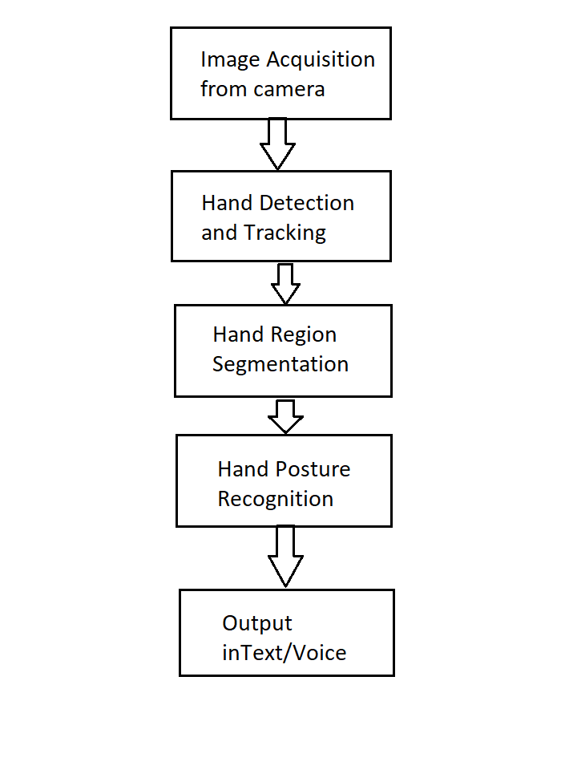
UML DIAGRAMS
SYSTEM FLOWCHART:
This is a block diagram of a hand recognition system, which is a type of computer vision system that can recognize hand gestures. Hand recognition systems are used in a variety of applications, such as sign language recognition, human-computer interaction, and virtual reality.

Slide 15
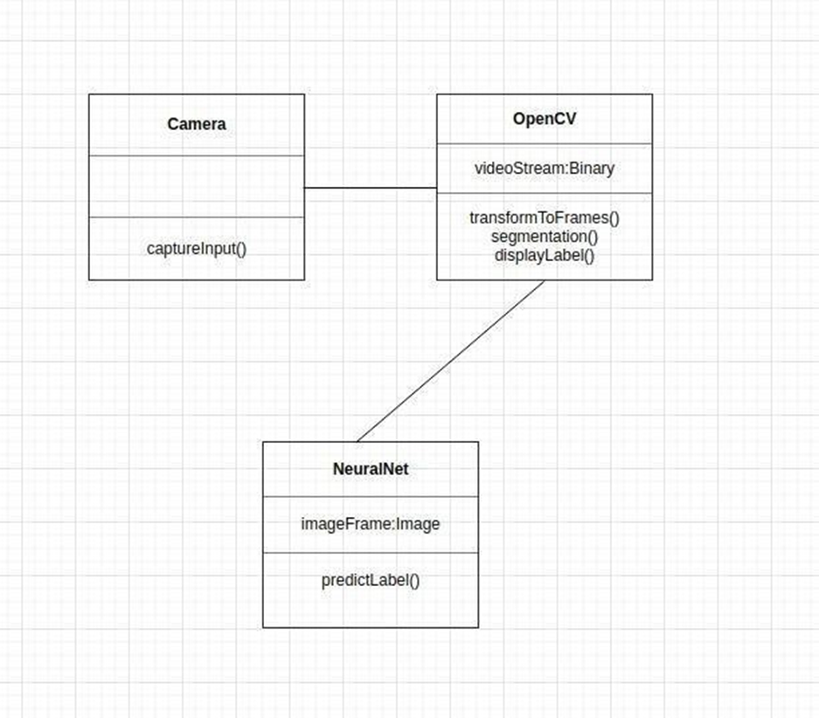
CLASS DIAGRAM
Class diagrams model class structure and contents using design elements such as classes, packages and objects. Class diagram describe the different perspective when designing a system:- conceptual, specification and implementation. Classes are composed of three things: name, attributes, and operations. Class diagram also display relationships such as containment, inheritance, association etc. The association shows the relationship between instances of classes.
Fig 5.2.1 Class Diagram

Slide 16
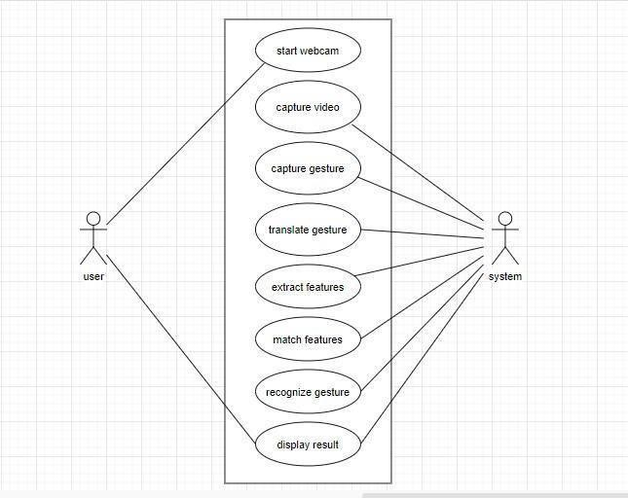
USE CASE DIAGRAM
A use case diagram in the Unified Modeling Language (UML) is a type of behavioural diagram defined by and created from a Use-case analysis. Its purpose is to present a graphical overview of the functionality provided by a system in terms of actors, their goals (represented as use cases), and any dependencies between those use cases.

Slide 17
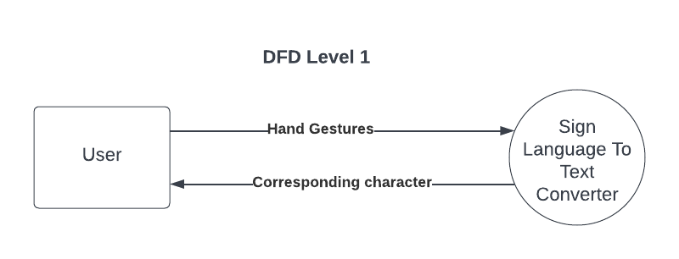
DFD DIAGRAM:
A Data Flow Diagram (DFD) is a traditional way to visualize the information flows within a system. A neat and clear DFD can depict a good amount of the system requirements graphically. It can be manual, automated, or a combination of both. It shows how information enters and leaves the system, what changes the information and where information is stored. The purpose of a DFD is to show the scope and boundaries of a system as a whole. It may be used as a communications tool between a systems analyst and any person who plays a part in the system that acts as the starting point for redesigning a system.

Slide 18
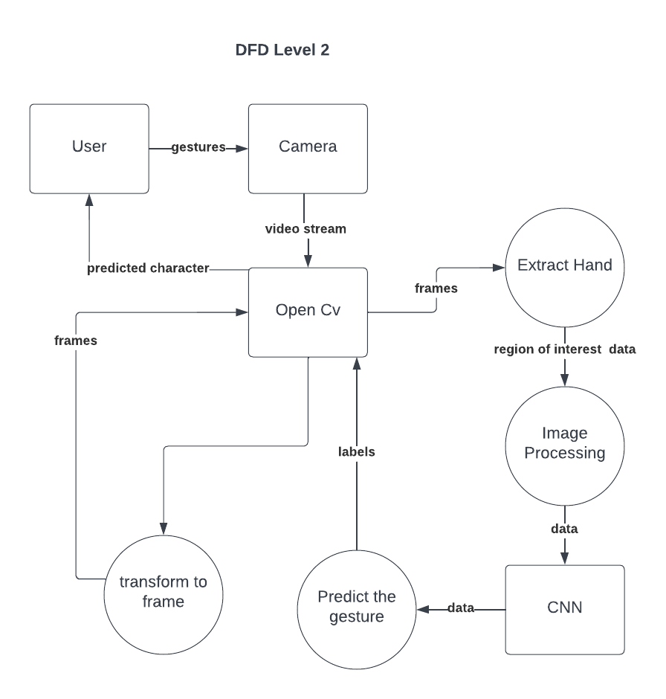

Slide 19
SEQUENCE DIAGRAM:
A sequence diagram in Unified Modeling Language (UML) is a kind of interaction diagram that shows how processes operate with one another and in what order. It is a construct of a Message Sequence Chart. Sequence diagrams are sometimes called event diagrams, event scenarios, and timing diagrams.
This sequence illustrates the flow of information from gesture capture to text generation in real time. The model plays a crucial role in recognizing sign language gestures and converting them into meaningful text.

Slide 20
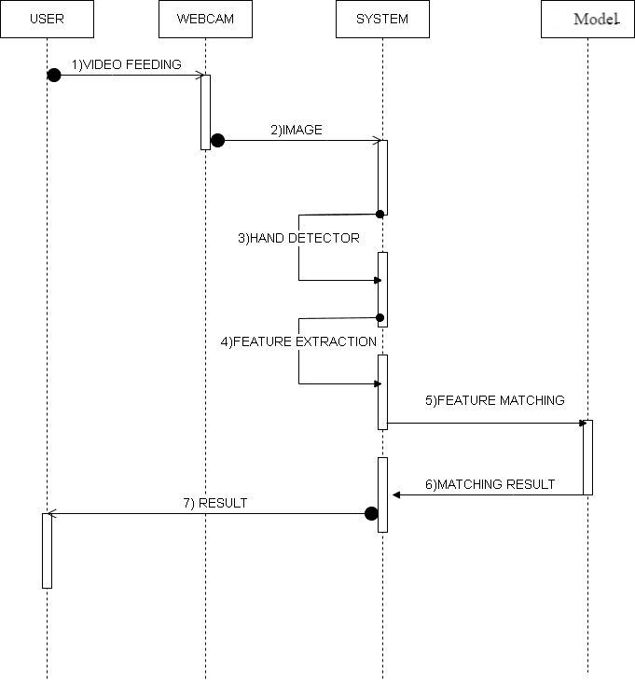

Slide 21
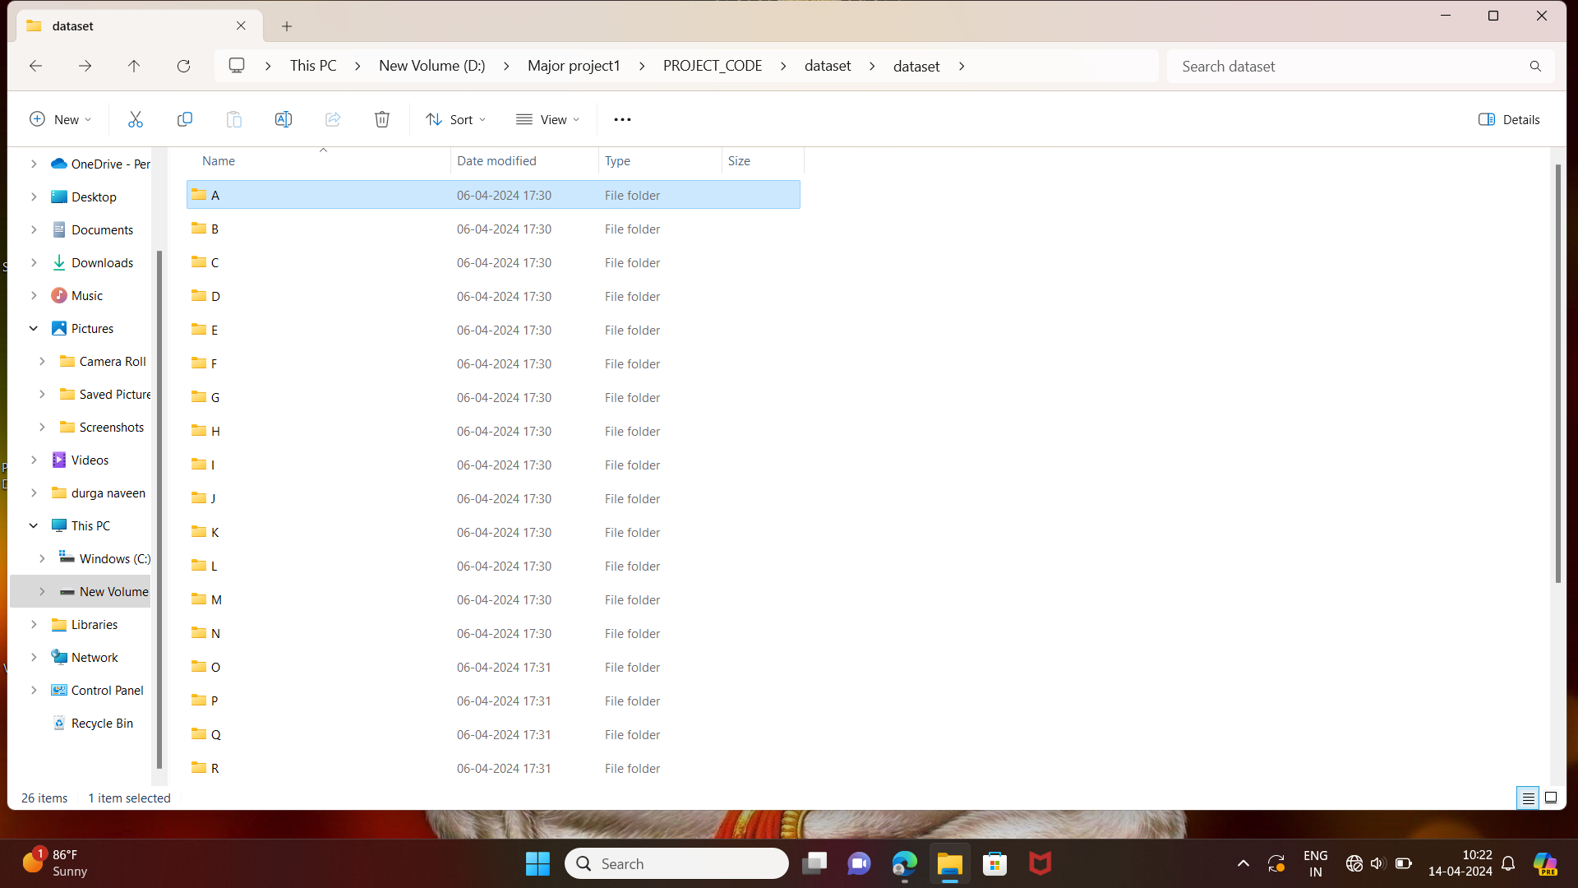
SCREENSHOTS
We have collected images of different signs of different angles for sign letter A to Z
Fig : Folders contains ASL Gestures

Slide 22
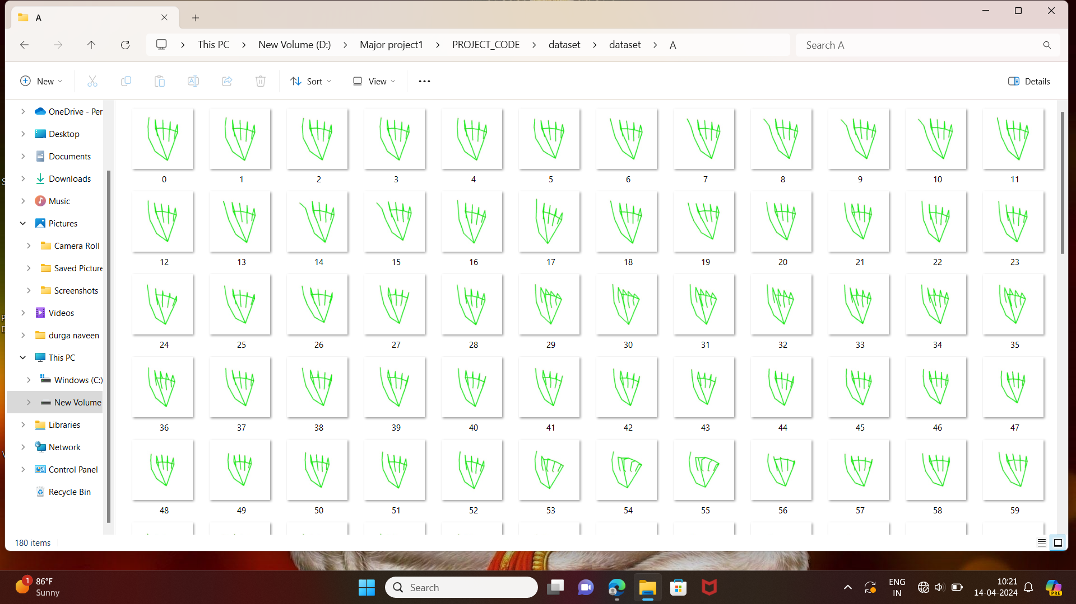
ASL gesture Images:
Fig : Each Sign gesture Contains 180 skeleton Images

Slide 23
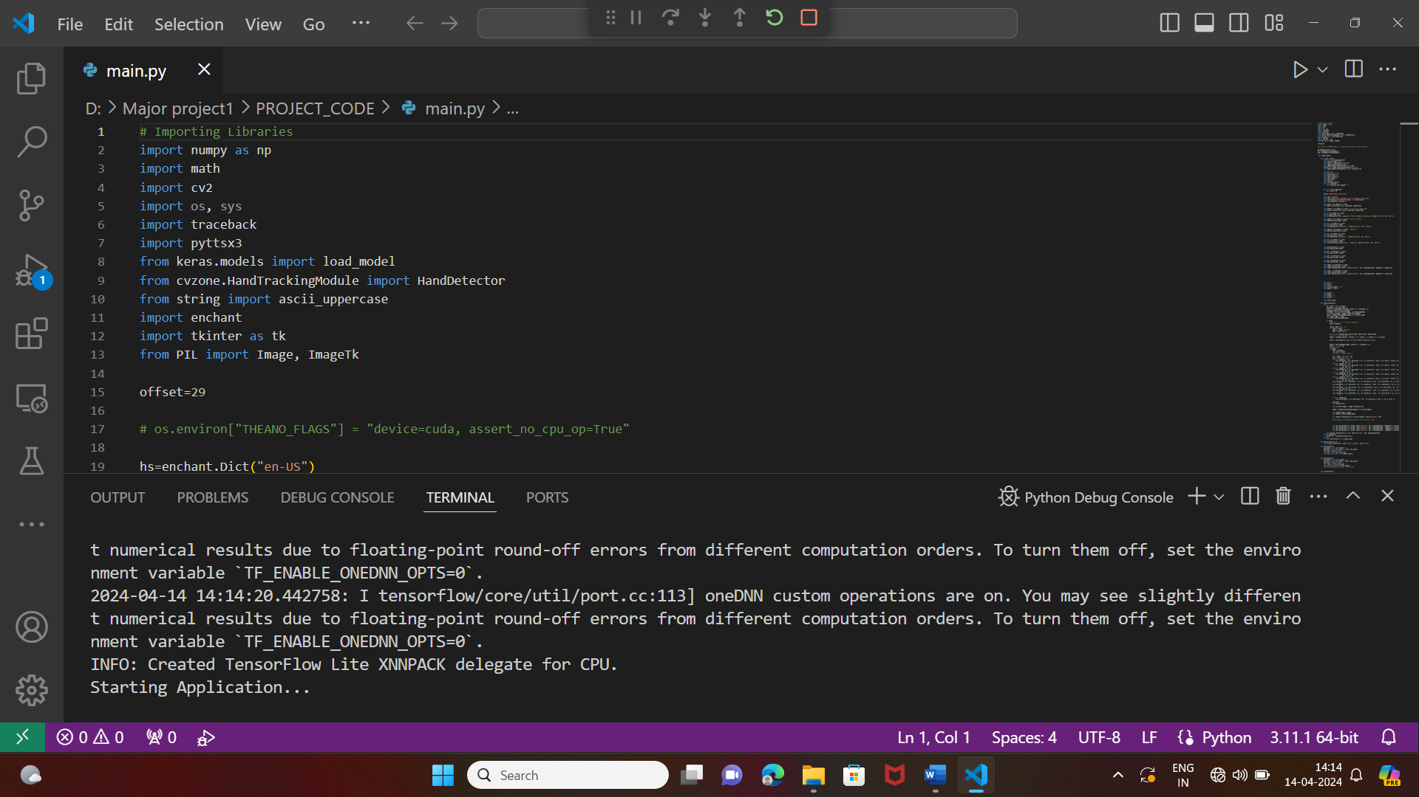
Fig : Starting application

Slide 24
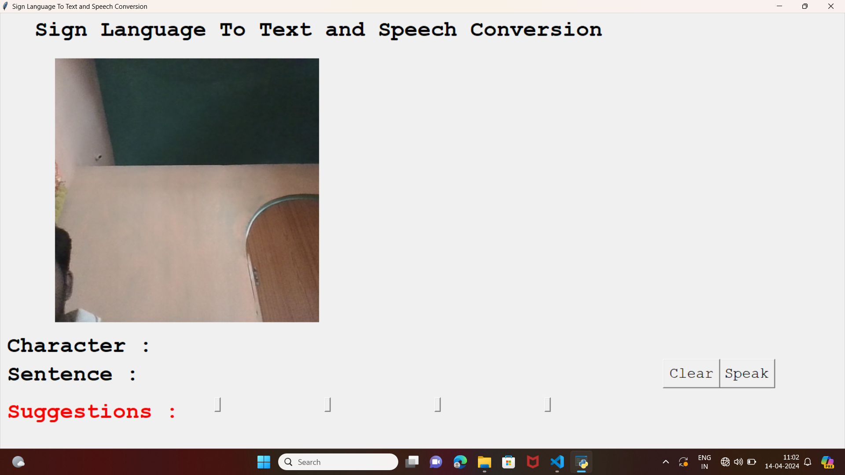
Fig : output in windows

Slide 25
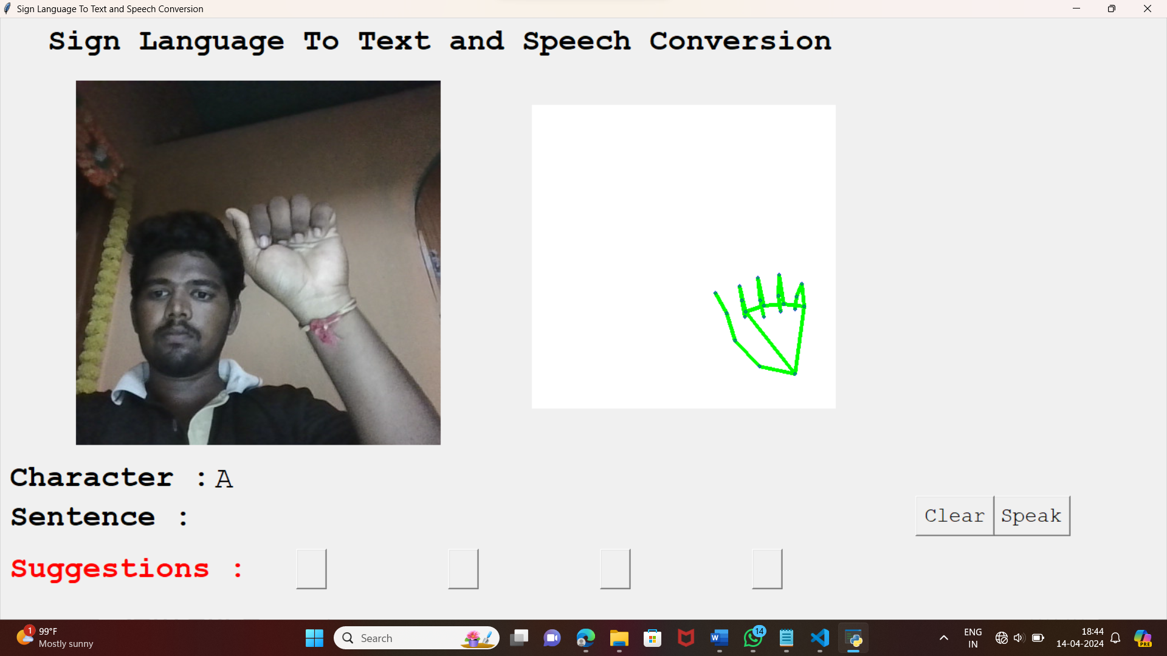

System Output screen displaying translates to the input image as alphabet A:
Fig : Output A

Slide 26
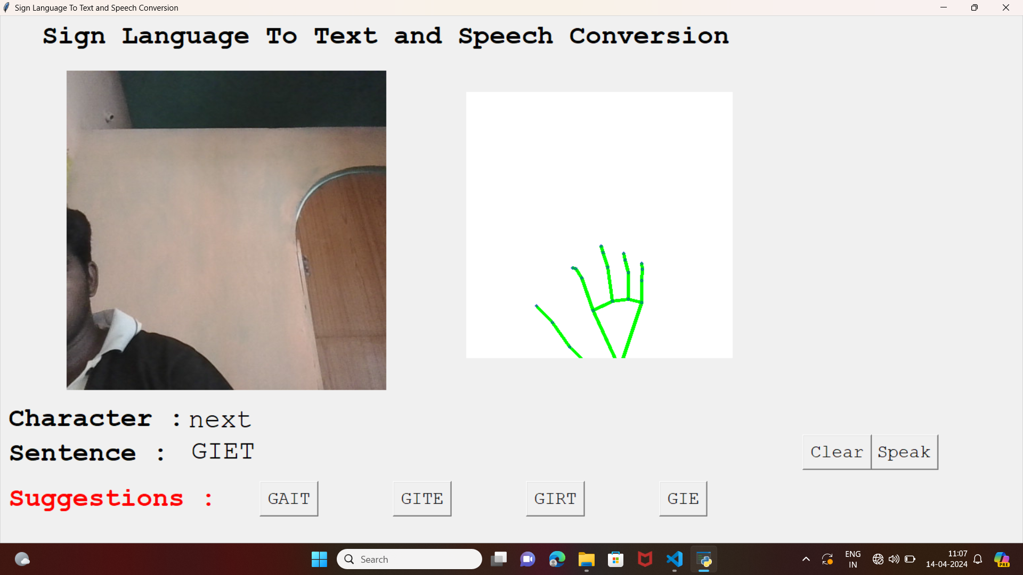

Fig : Final Output by using assigned gestures

Slide 27

Fig 8.3.3 Suggestions given based on the current word

Slide 28
CONCLUSION
The proposed a prototype model can recognize and classify the American Sign Language using the deep structured learning techniques called CNN. The method takes hand gesture image as input using a webcam and gives text and speech as an output. The project demonstrated the feasibility and usefulness of such a system for facilitating communication between sign language users and non-sign language users, as well as for promoting accessibility and inclusivity for people with hearing and speech impairments. . The sentence creation algorithm significantly helped boost the accuracy of the model in real-time and improved the interface making it more user friendly. The main objective has been achieved, that is, the need for an interpreter has been eliminated. From the process, we can conclude that CNN is an efficient technique to categorize hand gestures with high degree of accuracy.

Slide 29
REFERENCES
1. aeshpande3.github.io/A-Beginner%27s-Guide-To-Understanding-Convolutional-Neural-Networks.
2. Pigou L., Dieleman S., Kindermans PJ., Schrauwen B. Sign Language Recognition Using Convolutional Neural Networks. In: Agapito L., Bronstein M., Rother C. (eds) Computer Vision- ECCV Workshops. ECCV. Lecture Notes in Computer Science, vol 8925. Springer, Cham
3. https://en.wikipedia.org/wiki/Convolutional_neural_network
4. https://www.geeksforgeeks.org/project-idea-sign-language-translator-speech-impaired/
5. https://en.wikipedia.org/wiki/American_Sign_Language

Slide 30
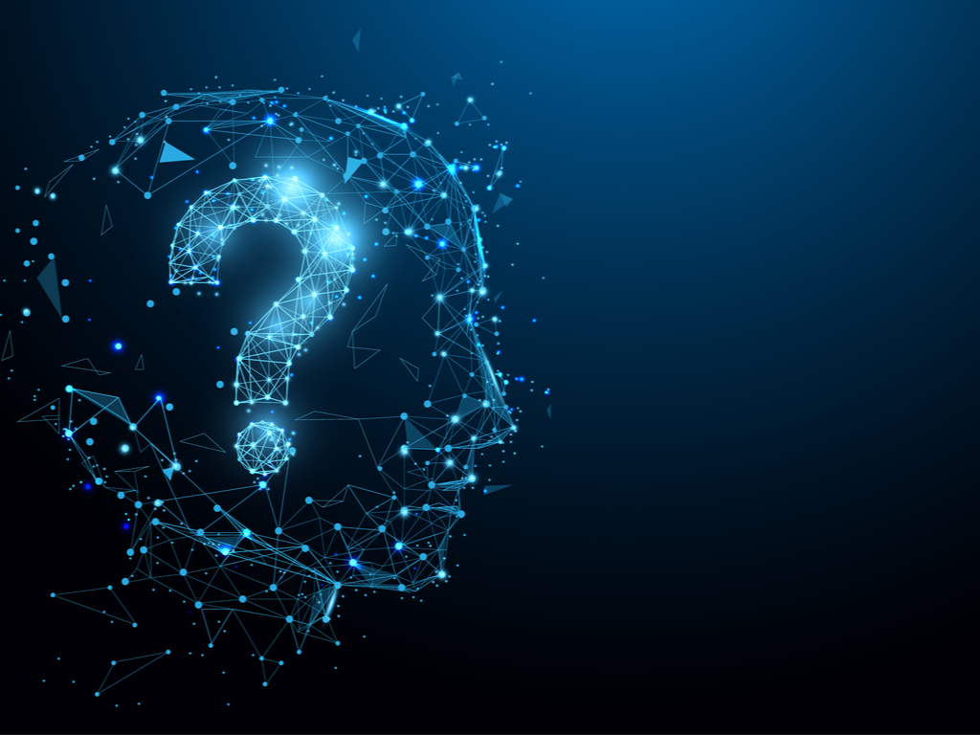
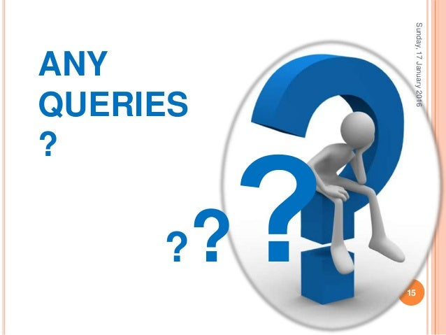
QUERIES

Slide 31


